Slide 1

Item Analysis

Slide 2
Analysis and Revision
Overall Difficulty for the entire test
  You look at the mean score
  Problematic situation: Overly high or overly low
    Mean overly high: ceiling effects – discrimination against the high-achievers; favor the low-achievers and medium-achievers
    Mean overly low: flooring effects- discrimination against the medium- and high-achievers.
Variability
  Standard deviation.
  Larger standard deviation, more the test discriminates.

Slide 3
Analysis and Revision
Variability
  Standard deviation indicates how the test takers’ performances are distributed
  The larger standard deviation, more the test discriminates

Slide 4
Analysis and Revision
Difficulty of each item.
Discrimination or validity of each item.
Quality of each response.
  Quality distractors: In a multiple choice test, some students should select each distractor(s).

Slide 5
Item Analysis
For each question you created, you may conduct item analysis on the following three dimensions:
Difficulty of each item.
Discrimination of each item.
Should be conducted whenever a test is used for the first time.

Slide 6
Item Analysis
Identify upper and lower groups.
Using the total test score to identify:
  Upper group: students who had the top 27% of scores.
  Lower group: students who had the bottom 27% of scores.
The upper and lower groups must have same number of scores.

Slide 7
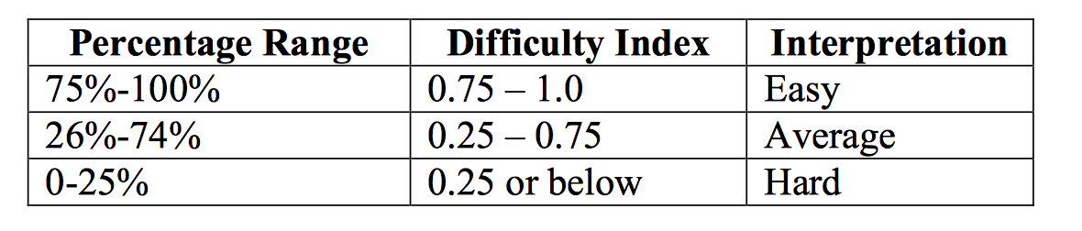
Item Difficulty (D)
D = (# correct in upper + # correct in lower)
(# in upper + # in lower)

Slide 8
Example for Difficulty Analysis
31 students: 8 in upper group, 8 in lower group
Item A B C* D E
1 Upper II I IIIII Lower I III II I I
D = (# correct in upper + # correct in lower)
(# in upper + # in lower)
D = (5 + 2) ÷ (8 + 8) = .4375

Slide 9
Item Difficulty (D)
Percentage of students that chooses correct answer.
D is high when the item is easy.
  if 90% got item correct, D = .90
  if 30% got item correct D = .30

Slide 10
Discrimination Index (r)
How well item discriminates between those who did well and those who did poorly on test.
Correlation between scores on one item and scores on total test.
Range: -1.0 to +1.0
Item validity

Slide 11
Discrimination Index (r)
R = (# correct in upper - # correct in lower)
(# in one group)

Slide 12
Example for Discrimination Analysis
31 students: 8 in upper group, 8 in lower group
Item A B C* D E
1 Upper II I IIIII Lower I III II I I
R = (# correct in upper - # correct in lower)
(# in each group)
r = (5 - 2) ÷ 8 = .375

Slide 13
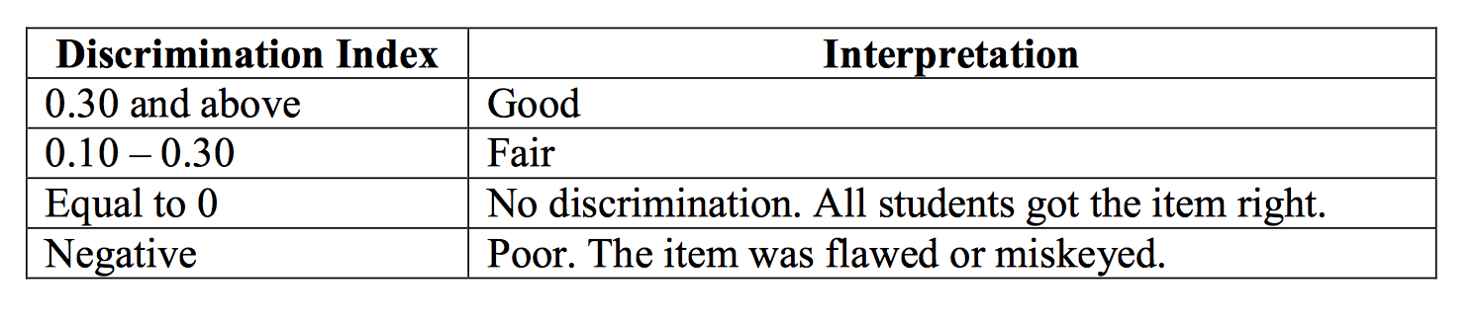
Discrimination Index (r)
R = (# correct in upper - # correct in lower)
(# in one group)

Slide 14
Quality of Each Response.
The last step is to look at distractors
  How many students chose each distractor?
  Ideal situation: For each distractor, you have some students chosen it.
  Problematic situation: You have one or two distractors that attracted very few students or no students to chose it/them (Choices D & E below).
Item 1 A B C* D E
Upper II I IIIII Lower III III II

